Slide 1
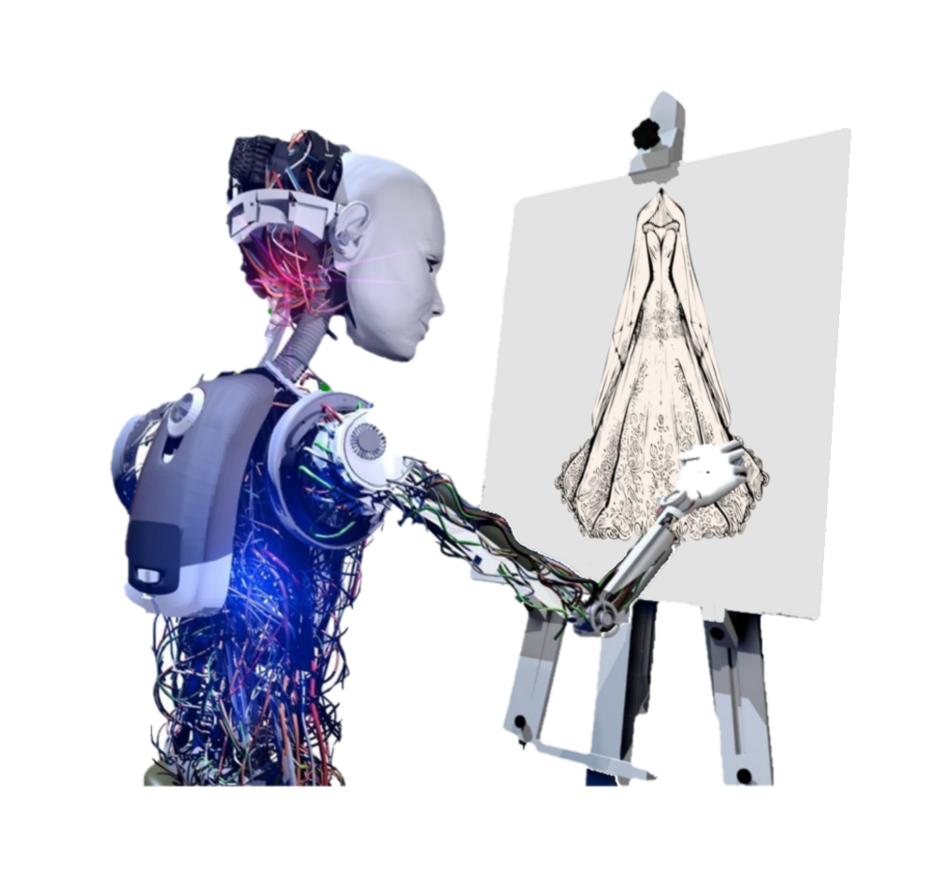
TAILOR

Slide 2
Team members
Amgad Abdelbaset Abdel Gawad
Andrew Nassef Amin
Andre Adel Ibrahim
Maria Maurice Ayoub
Mayve Ehab Rasmy
Mina Samy Anwar

Slide 3
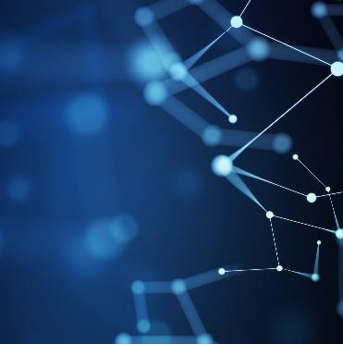
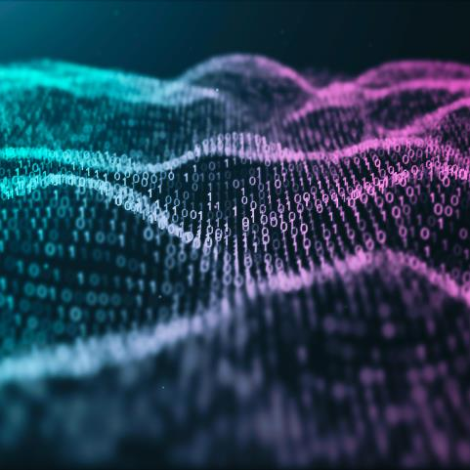
Supervisors
Name | Department
Dr. Salsabil Amin | Basic Sciences Department
T.A. Mohamed Essam | Bioinformatics

Slide 4
Agenda
1. Introduction
2. Problem Definition & Motivation
3. Objective & Related Works
4. System Architecture (i.e. Project Phases)
5. Phases description
6. Datasets
7. Experiments & Results
8. Demo
9. Conclusion & future work
10. References

Slide 5

Introduction
TAILOR is an AI art generator that generates fashion designs like wedding dresses, casual wear, … using stable diffusion model.

Slide 6
Problem Definition
There is a need for an efficient and accessible way for users to generate custom images of wedding dresses or casual wear based on their own text inputs.
Traditionally, designing custom clothing can be a time-consuming and expensive process, requiring the skills of a professional designer or costly software.

Slide 7
Motivation
Time and cost savings: By allowing users to create their own unique designs, that can help save them time and money, the average cost of a wedding dress design ranges from $2,000 - $8,000, and the average cost of casual wear design $200 - $250.
Customization: According to a survey by The Wedding Report, 83% of brides want a personalized wedding dress. By using AI users can create a dress that is tailored to their specific preferences.
Accessibility: Not everyone has access to high-end fashion designers or the budget to purchase expensive clothing.

Slide 8
Objective
Build a maintainable and usable application that can take clothes descriptions as text and generates a new image containing the clothes with the desired description that the user provided in the text input.

Slide 9
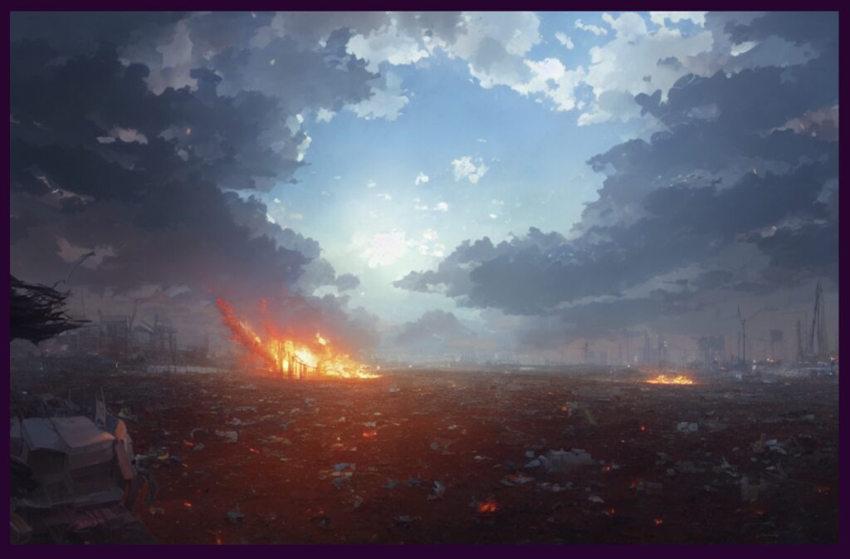
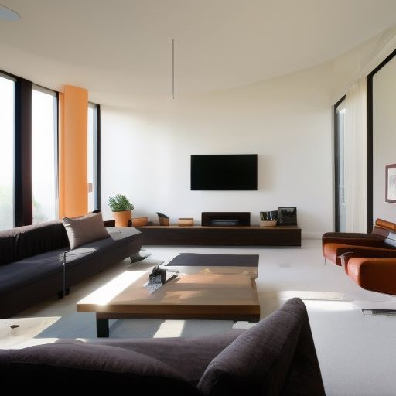
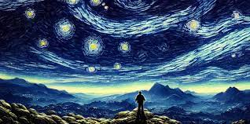
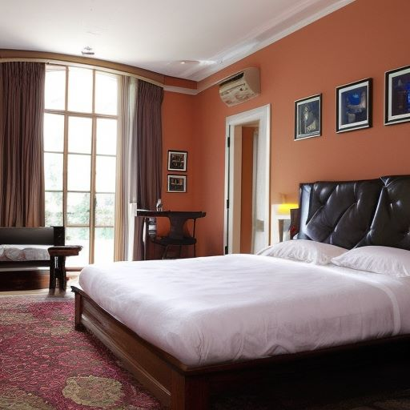
Related Works
Stable Diffusion:
An Artificial Intelligence (AI) Art Generator app that allows you to create your own amazing artworks.

Slide 10
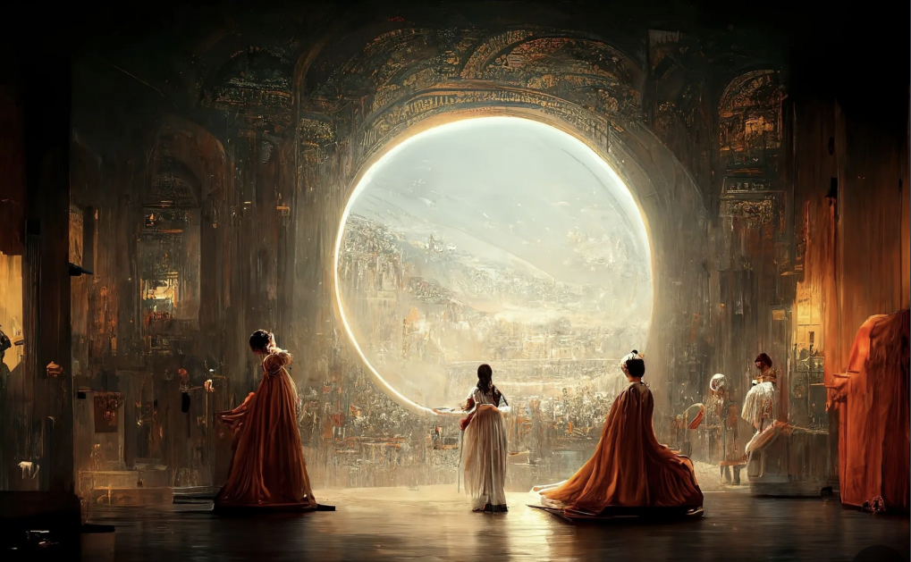
Related Works
Midjourney:
An independent research lab that produces a proprietary artificial intelligence program that creates images from textual descriptions.

Slide 11
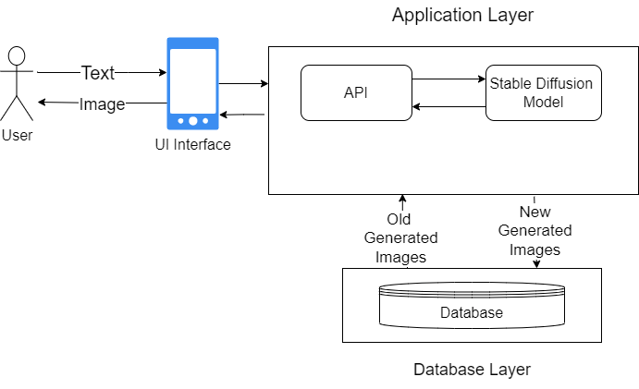
System Architecture

Slide 12

Phases Description

Slide 13
Modeling
Model Planning:
In this phase we started to do some research on the available techniques and methods that can help us in our project.
The most famous methods are: 1- DreamBooth 2- Textual Inversion 3-LoRa 4-Keras-cv method.
Model Selection:
In this phase we were trying to select the best model we can use for our project that depend on the Stable Diffusion model.
We decided to go with the Stable Diffusion model because they can generate a wider variety and higher quality of images than GANs.

Slide 14
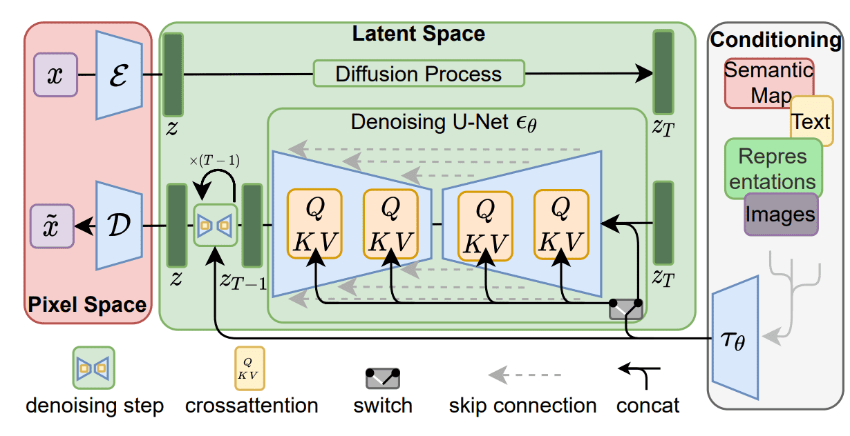
Model Architecture

Slide 15
Model Implementation:
In this phase we started to implement the model and started to tune its hyperparameters to be more biased to our project objective.
Model Training:
In this phase we started the training process by giving the model our dataset after we tuned the hyperparameters.
We trained the model for 90+ epochs.

Slide 16
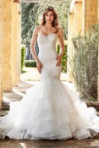
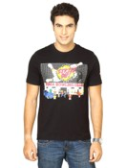
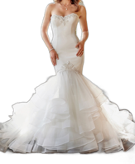
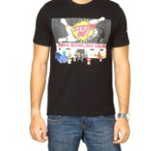
Data Preprocessing
Preprocessing on images:
Background removal.
Face segmentation.
Description preprocessing (summarization):
Summarize the text prompt by getting the most important sentences in the description, enter the output of step 1 to T5-transformer to summarize the description according to the meaning of the entered sentences.

Slide 17
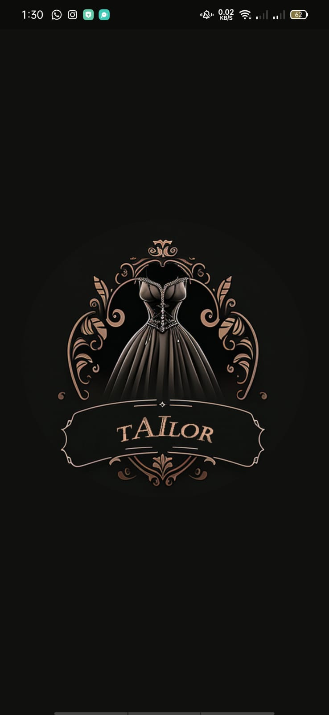
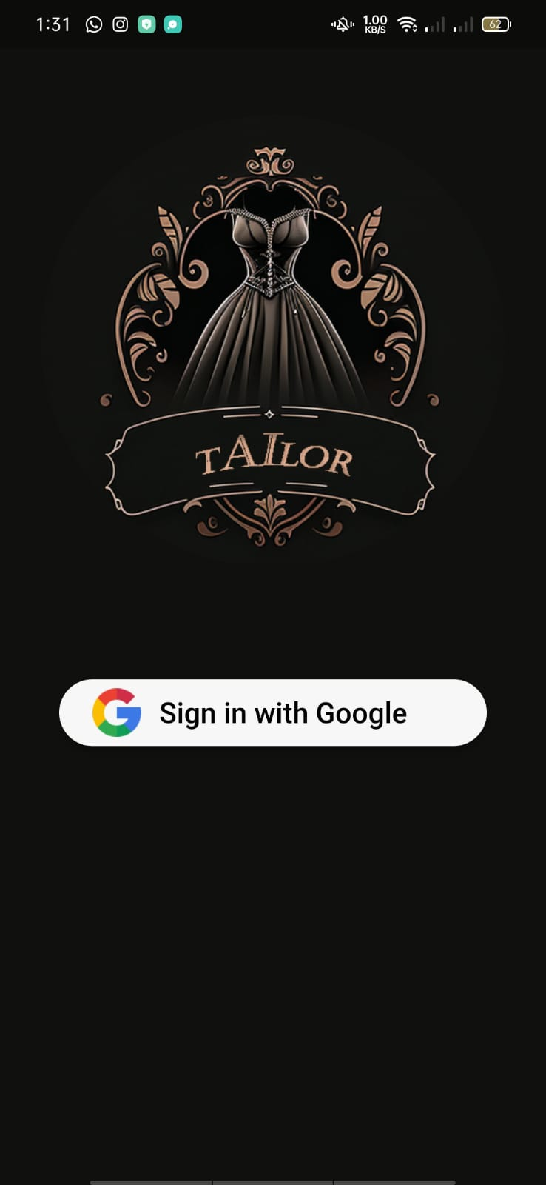
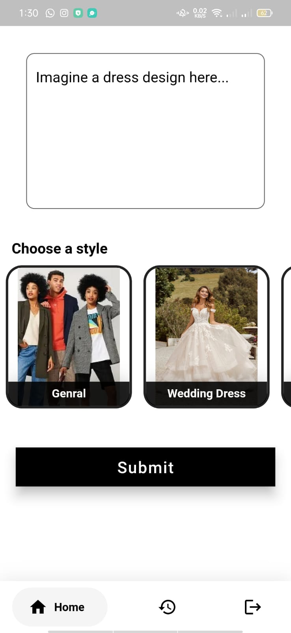
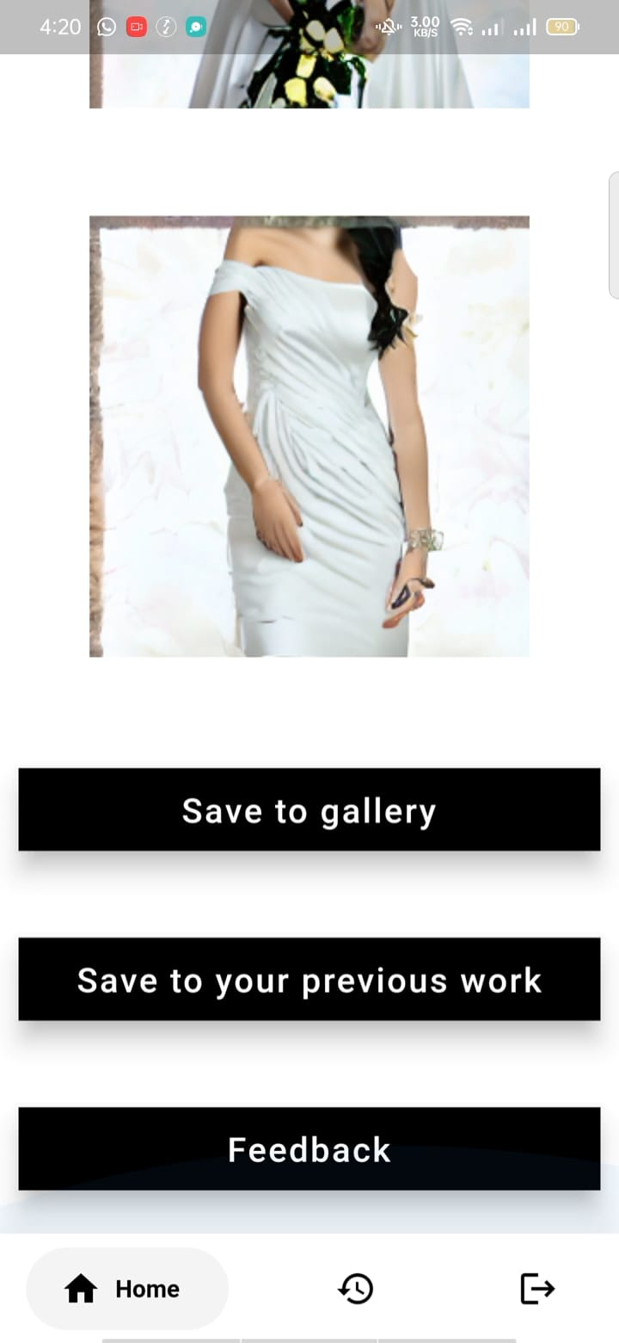
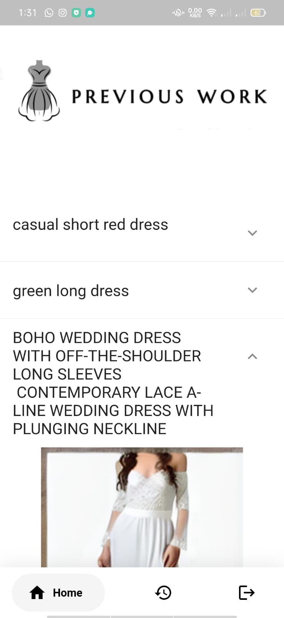
Front End Design

Slide 18
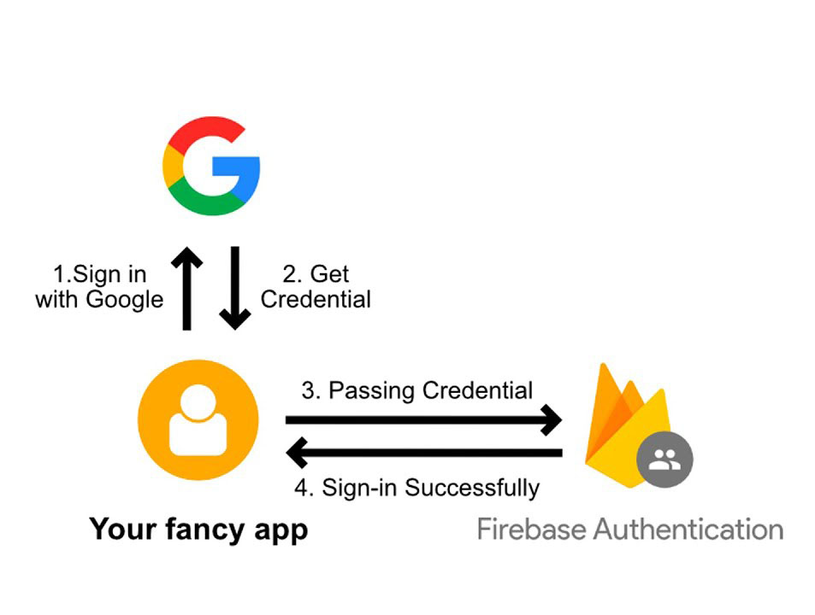
Backend End Implementation
MVC modular design pattern
Sign with Google
Connecting to models by REST API

Slide 19
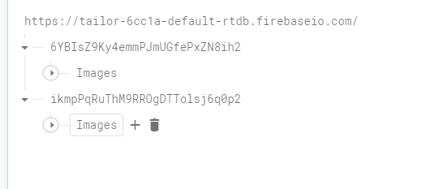
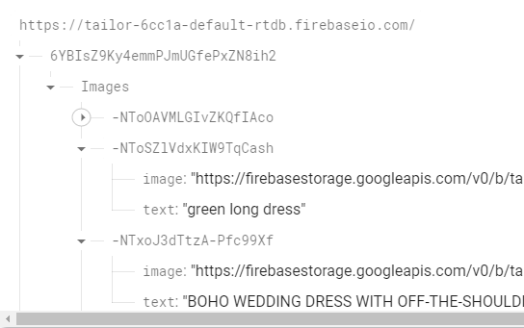
Backend End Implementation
Saving previous work of each user and Feedbacks using Firebase real-time database.

Slide 20
Description of Datasets

Slide 21
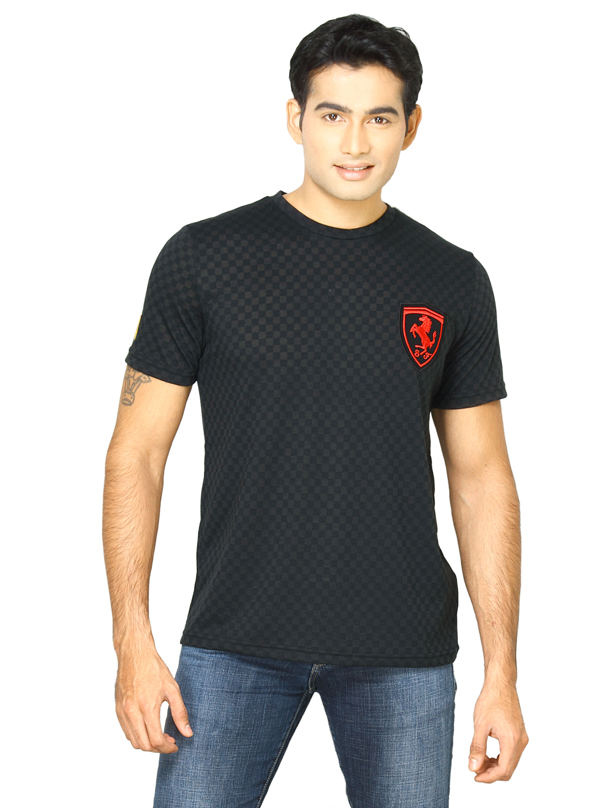
First Dataset
Fashion Product Images Dataset | Kaggle.
21K of fashion products images divided into two subcategories (top wear , bottom wear).
10 features describing the product such as gender ,base color, year ,….

Slide 22
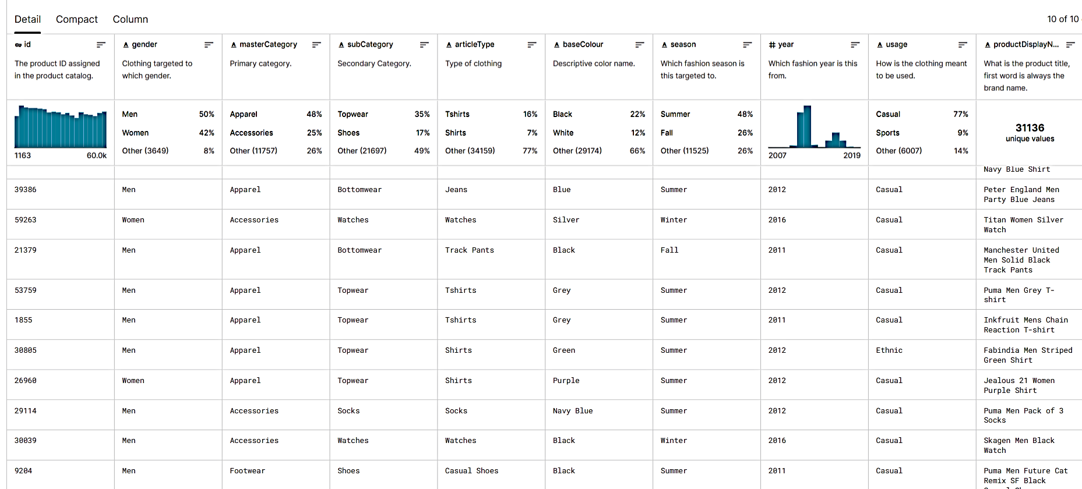
Glimpse of The Dataset

Slide 23
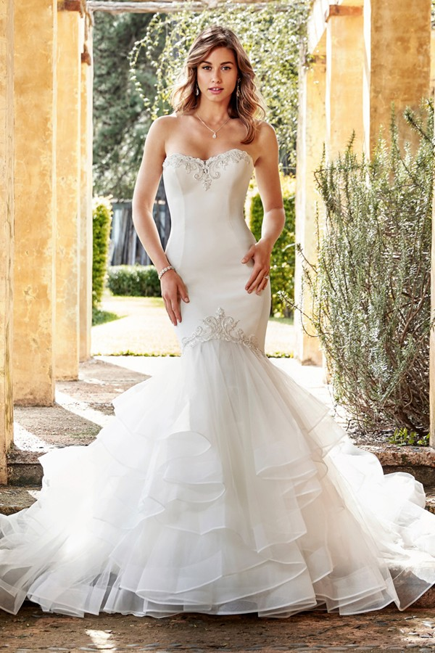
Second Dataset
660 of collected wedding dresses images with detailed description.
Resources :
Sophiatolli
NewYork dress
Essense Designs

Slide 24
Glimpse of The Dataset
ID | Description
0 | The bodice is rich in sequin lace, with floral details trimming the illusion neckline and off-the-shoulder straps which lead to an awe-inspiring low illusion back, with floral lace trimming and fabric buttons.
1 | The bodice is rich in sequin lace, with floral details trimming the illusion neckline and off-the-shoulder straps which lead to an awe-inspiring low illusion back, with floral lace trimming and fabric buttons.
2 | The eye-catching V-neck bodice is encrusted with beaded embroidery and is supported by beaded embellished spaghetti straps that lead to a beaded edge of the modest high back with dramatic detail.
3 | from back, The eye-catching V-neck bodice is encrusted with beaded embroidery and is supported by beaded embellished spaghetti straps that lead to a beaded edge of the modest high back with dramatic detail.
4 | The eye-catching sweetheart neckline adorned with beaded lace perfectly sculpts the body and leads to off-the-shoulder lace straps that add a stylish touch. The voluminous tulle skirt flares out below the hips to bring the drama, with bold lace appliques placed around the hem to finish the gown glamorously.
5 | Boho wedding dress with off-the-shoulder long sleeves

Slide 25
Experiments & Results
We used Fréchet Inception Distance (FID) which is a measure of similarity between two datasets of images .
These two datasets are essentially the dataset of real images and the dataset of fake images (generated images in our case). FID is usually calculated with two large datasets. However, we couldn’t use large dataset with the wedding dresses model.
In the casual wear model, we had a huge dataset, so we split the dataset and we choose unique prompts selected randomly from the entire dataset, while in the dresses model, we had to collect another 60 images of wedding dresses as it is a self-collected dataset and used them.

Slide 26
Experiments & Results
Casual Wear Model:
Test Dataset 2k image and training dataset 21k.
Model FID: 72.333
Wedding Dresses Model:
Test Dataset 60 image and training dataset 600.
Model FID: 94.666

Slide 27
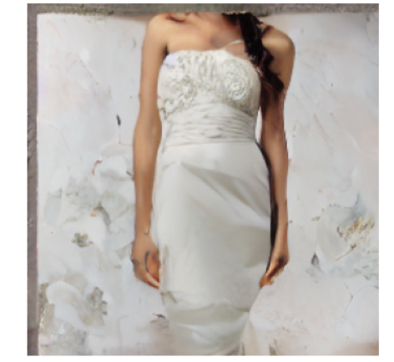
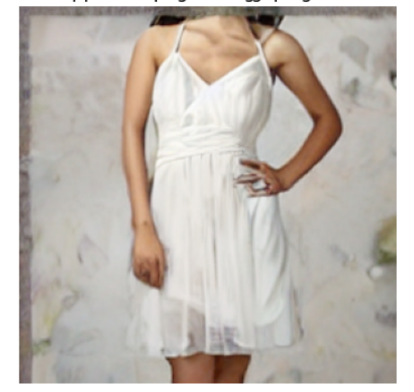
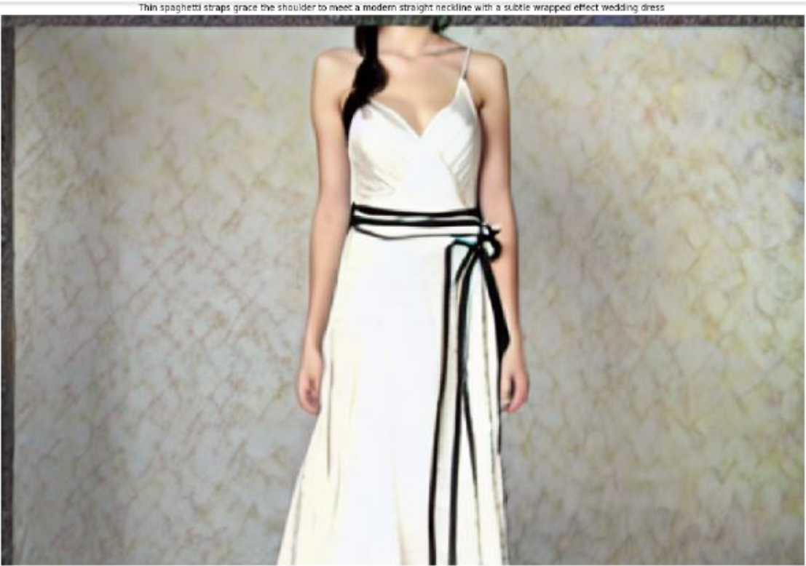
Experiments & Results
Wedding Dresses model
Thin spaghetti straps grace the shoulder to meet a modern straight neckline with a subtle wrapped effect wedding dress
10+ epochs
50+ epochs
90+ epochs

Slide 28
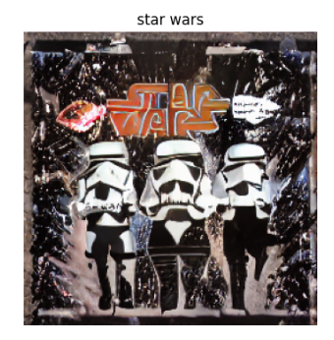
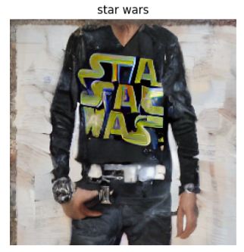
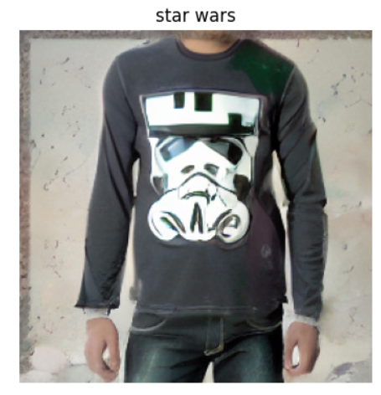
Experiments & Results
Casual wear model
Star Wars
10+ epochs
50+ epochs
90+ epochs

Slide 29
DEMO

Slide 30


Slide 31
Conclusion
In conclusion, the virtual clothing customization system presented in this project showcases the successful integration of natural language processing and image generation techniques. It provides users with a seamless and interactive platform to personalize clothing items based on their preferences. The system's ability to generate realistic and contextually relevant images is a testament to the effectiveness of the diffusion model and algorithm employed.

Slide 32
Future Work
The project opens possibilities for further enhancements and extensions, such as incorporating additional clothing categories, refining the user interface, and integrating more advanced image generation models. With continuous development and improvement, the system has the potential to revolutionize the way users interact with virtual clothing customization.
1) Train both models on more images.
2) Add more categories.
3) Enhance the user experience.

Slide 33
References
[1] Blattmann, A., Rombach, R., Oktay, K. and Ommer, B., 2022. Retrieval-Augmented Diffusion Models. arXiv preprint arXiv:2204.11824.
[2] Feng, Z., Zhang, Z., Yu, X., Fang, Y., Li, L., Chen, X., Lu, Y., Liu, J., Yin, W., Feng, S. and Sun, Y., 2022. ERNIE-ViLG 2.0: Improving Text-to-Image Diffusion Model with Knowledge-Enhanced Mixture-of-Denoising-Experts. arXiv preprint arXiv:2210.15257.
[3] Li, R., Li, W., Yang, Y., Wei, H., Jiang, J. and Bai, Q., 2022. Swinv2-Imagen: Hierarchical Vision Transformer Diffusion Models for Text-to-Image Generation. arXiv preprint arXiv:2210.09549.

Slide 34
References
[4] Balaji, Y., Nah, S., Huang, X., Vahdat, A., Song, J., Kreis, K., Aittala, M., Aila, T., Laine, S., Catanzaro, B. and Karras, T., 2022. ediffi: Text-to-image diffusion models with an ensemble of expert denoisers. arXiv preprint arXiv:2211.01324.
[5] Yu, J., Xu, Y., Koh, J.Y., Luong, T., Baid, G., Wang, Z., Vasudevan, V., Ku, A., Yang, Y., Ayan, B.K. and Hutchinson, B., 2022. Scaling autoregressive models for content-rich text-to-image generation. arXiv preprint arXiv:2206.10789.
[6] Ramesh, A., Dhariwal, P., Nichol, A., Chu, C. and Chen, M., 2022. Hierarchical text-conditional image generation with clip latents. arXiv preprint arXiv:2204.06125.

Slide 35
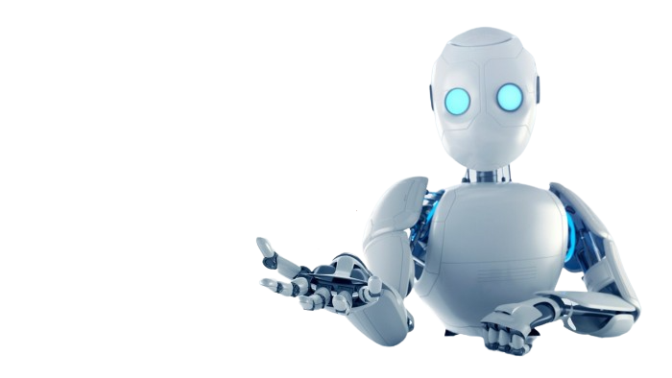
Thank You

